Slide 1

PowerShell Basics
Adam Driscoll
Adam Driscoll
Twitter: @adamdriscoll
adriscoll@concurrency.com
Senior Application Developer

Slide 2
Agenda
What is PowerShell?
Tooling
Language Basics
Pipeline
Help System
Module Basics
Lab

Slide 3
What is PowerShell?
Scripting language for Windows
Available since Windows Server 2008
Object based pipeline
Built-on .NET
Currently at version 5

Slide 4
Tooling
PowerShell.exe
PowerShell ISE
VS Code with PowerShell Extension
Visual Studio with PowerShell Extension
PowerShell Studio
ISE Steroids

Slide 5
Language Basics
Commands
Syntax
Help System
Pipeline
Drive System
Modules

Slide 6
Commands
Verb-Noun Syntax
Discoverable
Parameters

Slide 7
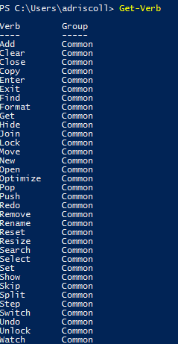
Command Format
Get-Process
Standard Verb
Singular Noun
Get-SCSMObject
98 Standard Verbs
Frequently prefixed

Slide 8
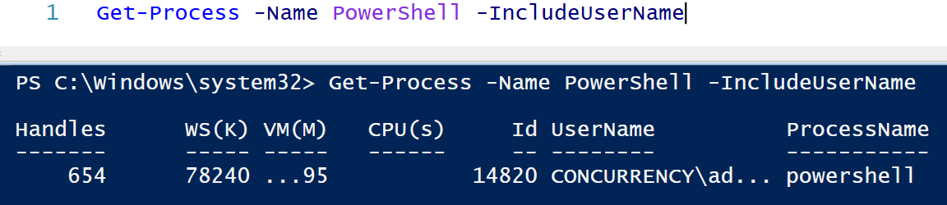
Command Parameters
Get-Help about_Parameters

Slide 9
Common Parameters
-Debug (db)
-ErrorAction (ea)
-ErrorVariable (ev)
-InformationAction
-InformationVariable
-OutVariable (ov)
-OutBuffer (ob)
-PipelineVariable (pv)
-Verbose (vb)
-WarningAction (wa)
-WarningVariable (wv
Get-Help about_CommonParameters

Slide 10
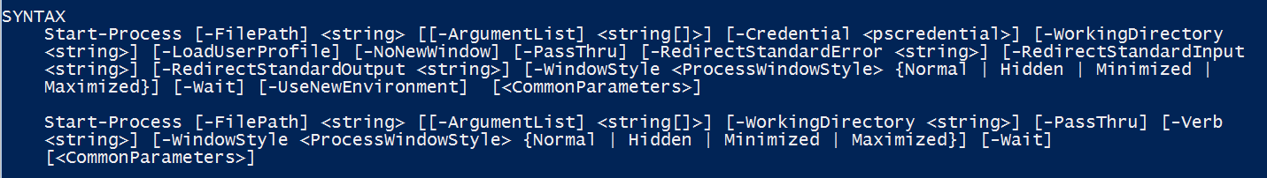
Parameter Sets
Defines grouped sets of parameters
Changes syntax of command based on parameters specified
Parameter Set 1
Parameter Set 2

Slide 11
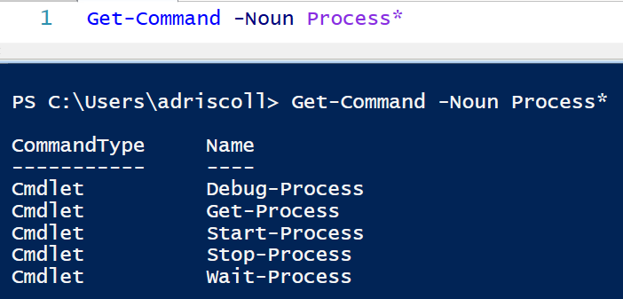
Command Discovery

Slide 12
Help System
Get-Help
Command Based Help
About Files
Extensible
Updatable
Get-Help Get-Help
Notes:
.\Start-Demo.ps1 –File .\Help.txt

Slide 13

Variables
Value
Variable Name
Data Type
Get-Help about_Variables
Notes:
.\Start-Demo –File .\Variables.txt

Slide 14
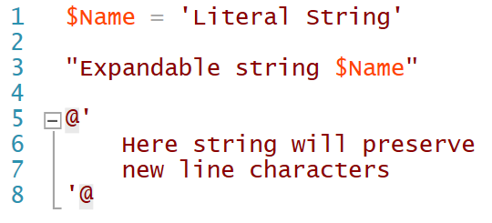
Strings
Notes:
.\Start-Demo.ps1 -File .\Strings.txt

Slide 15
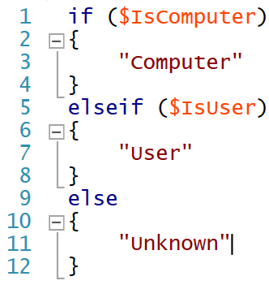
Conditional Operators
Condition
Expression Body
Get-Help about_If

Slide 16
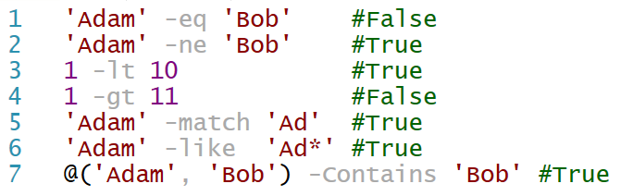
Comparison Operators
Get-Help about_Operators

Slide 17
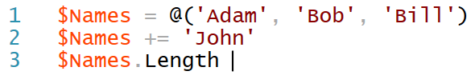
Arrays
Get-Help about_Arrays

Slide 18
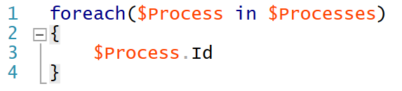
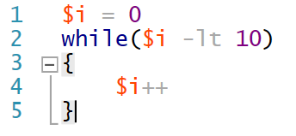
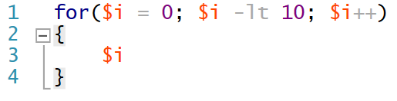
Loops
Get-Help about_ForEach
Get-Help about_For
Get-Help about_While

Slide 19
Objects
Objects rather than text
Objects have properties and methods
Objects can be formatted, filtered and extended
Get-Help about_Objects

Slide 20
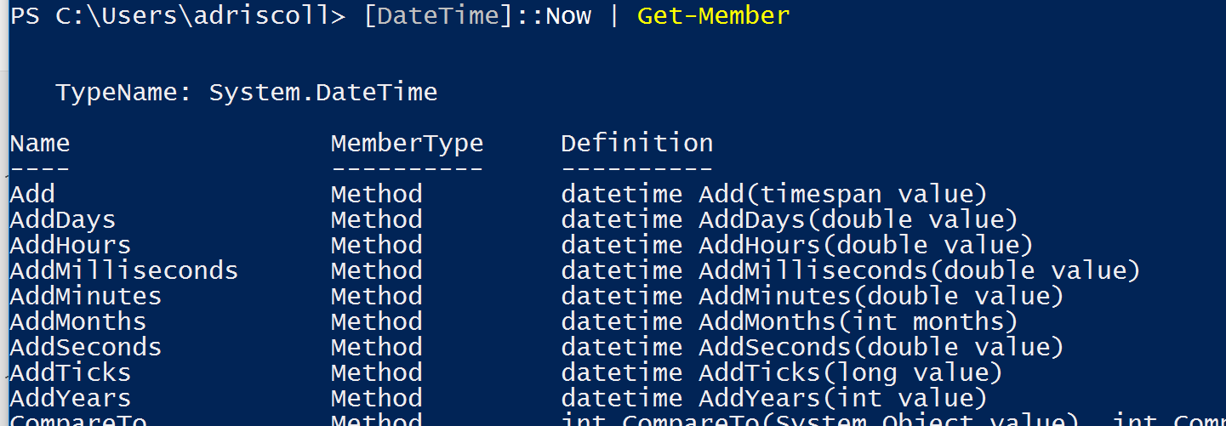
Get-Member

Slide 21
Pipeline
Chain commands together to perform aggregate operations
Simply looping statements
Deal with sets of objects easier
Get-Help about_Pipelines
Notes:
.\Start-Demo.ps1 –File .\Pipeline.txt

Slide 22
Aliases
Shorter syntax for commands
Can be exported from modules
Can be defined on the fly
Many built in aliases
Get-Help about_Aliases

Slide 23
Module Basics
Modules are collection of commands, formatting files, aliases or providers
Can be loaded on demand
Module installation locations ($Env:PSModulePath)
Install-Module – PowerShell Gallery
Get-Help about_Modules
Notes:
.\Start-Demo -File .\Modules.txt

Slide 24
PowerShell File Types
PS1 – PowerShell Script File
PSM1 – PowerShell Module File
PSD1 – PowerShell Data File
PS1XML – PowerShell XML File

Slide 25
PowerShell Resources
PowerShell.org
PowerShellGallery.com
PoshCode.org
Hey! Scripting Guys Blog

Slide 26
Lab
1. Get a list of processes that are using more than 100mb of RAM
2. Display all services and their state in a table.
3. Update the help on your machine. Find and use the command to display command history in your prompt.
4. List all modules currently installed on your machine.
5. Download and install a module from the PowerShell Gallery or GitHub
6. Discover all the commands within the module

